Slide 1
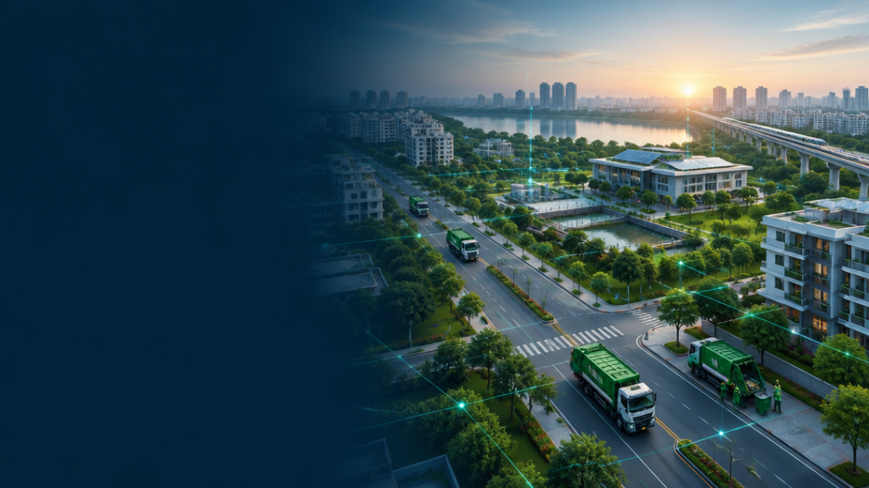
MACHINE LEARNING | DATA ANALYTICS | STREAMLIT
WasteWise
AI
ML-Based Municipal Solid Waste Generation Estimation & Collection-Priority Support Platform
WasteWise AI | Internship Final Project
01

Slide 2
The planning gap is not a data shortage
Waste changes by city and time—but collection decisions still depend on fragmented, manual interpretation.
Variation across cities and fiscal years
DATA
PLANNING GAP
COLLECTION CHALLENGE
Historical reports and spreadsheets
Manual judgment slows comparison
Higher collection needs are hard to spot
WasteWise AI | Internship Final Project
02

Slide 3
What WasteWise AI aims to do
01
02
03
Analyse historical waste across Indian cities
Build an explainable supervised regression model
Respect temporal order in evaluation
04
05
Translate estimates into priority bands
Enable interactive exploration and prediction
WasteWise AI | Internship Final Project
03

Slide 4
Dataset & data source
MoSPI · EnviStats India 2024 · Statement 3.06
414
46
9
307
city-year rows
cities
fiscal snapshots
observed targets
1999–00
2005–06
2010–11
2015–16
2022–23
CITY YEAR POPULATION WASTE (t/day)
Delhi 2022 16.8M 11,038
Pune 2022 3.1M 2,100
Mysuru 2022 1.0M 530
WasteWise AI | Internship Final Project
04

Slide 5
From raw data to model-ready data
RAW DATA
CLEANING
MISSING TARGET
FEATURE ENGINEERING
LEAKAGE CONTROL
MODEL READY
414 → 405 rows
307 observed targets
log1p target
log population
Leakage features excluded
WasteWise AI | Internship Final Project
05

Slide 6
ML methodology
Chronological by design: future observations never inform the past.
INPUT FEATURES
MODELS
EVALUATION
year_start
log_population
pop_tier
city
Dummy · Ridge
Random Forest
Gradient Boosting
Train 172 · Test 135
5-fold time-aware CV
TARGET · log1p(waste_generated)
WasteWise AI | Internship Final Project
06

Slide 7
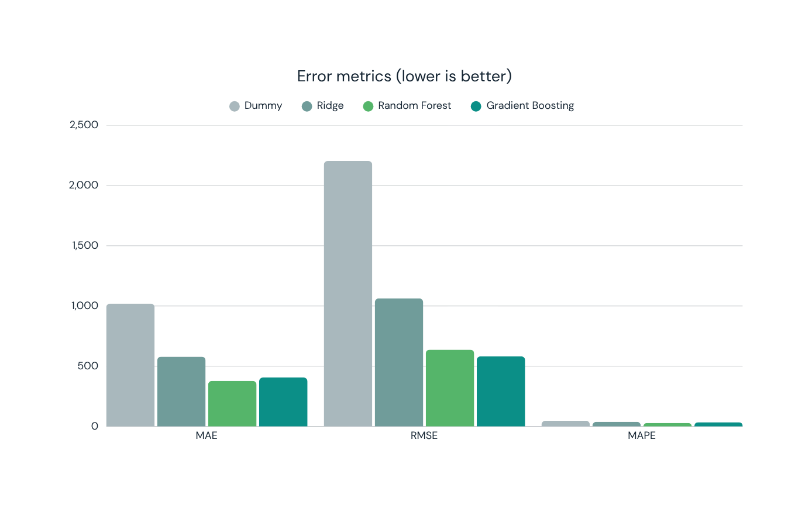
Model performance
Gradient Boosting leads on RMSE and R²; Random Forest leads on MAE and MAPE.
0.920
BEST R²
581.7
LOWEST RMSE
WasteWise AI | Internship Final Project
07

Slide 8
Why Gradient Boosting?
BEST TEST RMSE
581.7 t/day
HIGHEST TEST R²
0.920
BEST TIME-AWARE CV
log-RMSE 0.463
PRACTICAL FIT
Non-linear · small data
R² = 0.920 is not 92% accuracy.
WasteWise AI | Internship Final Project
08

Slide 9
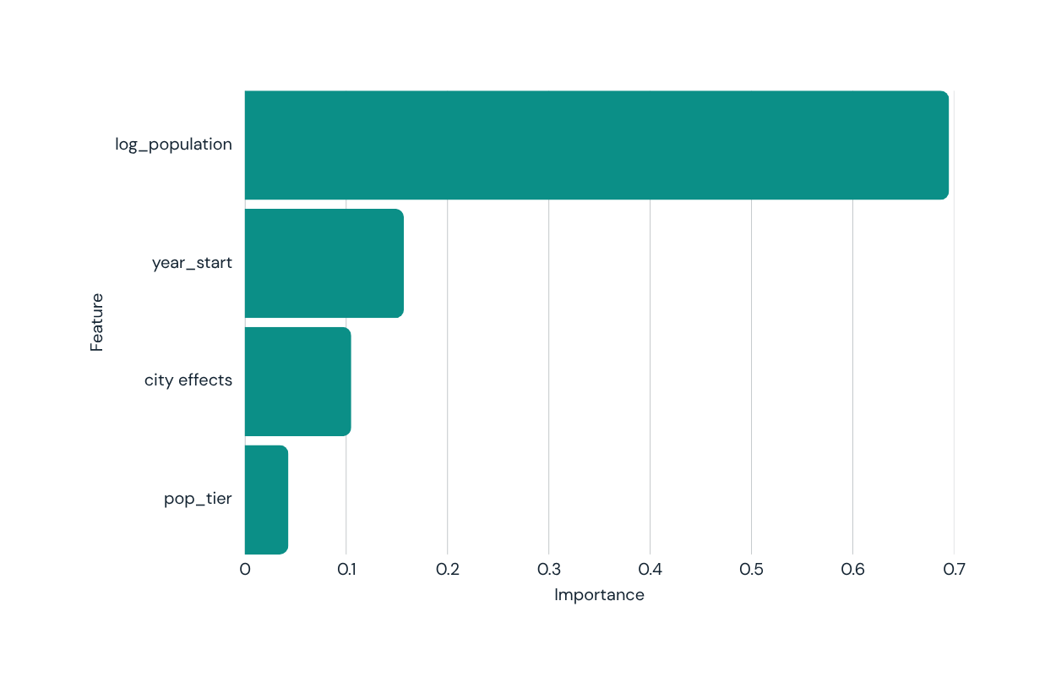
What drives the model?
Importance shows model reliance—not causation.
Population scale dominates
Time contributes meaningful signal
City and tier effects are smaller
WasteWise AI | Internship Final Project
09

Slide 10
From prediction to collection priority
Thresholds are frozen from the 172-row training period only.
PREDICTED WASTE
TRAINING THRESHOLDS
PRIORITY BAND
LOW
≤ 510.43 t/day
MEDIUM
> 510.43 to 1,010.0
HIGH
> 1,010.0 t/day
WasteWise AI | Internship Final Project
10

Slide 11
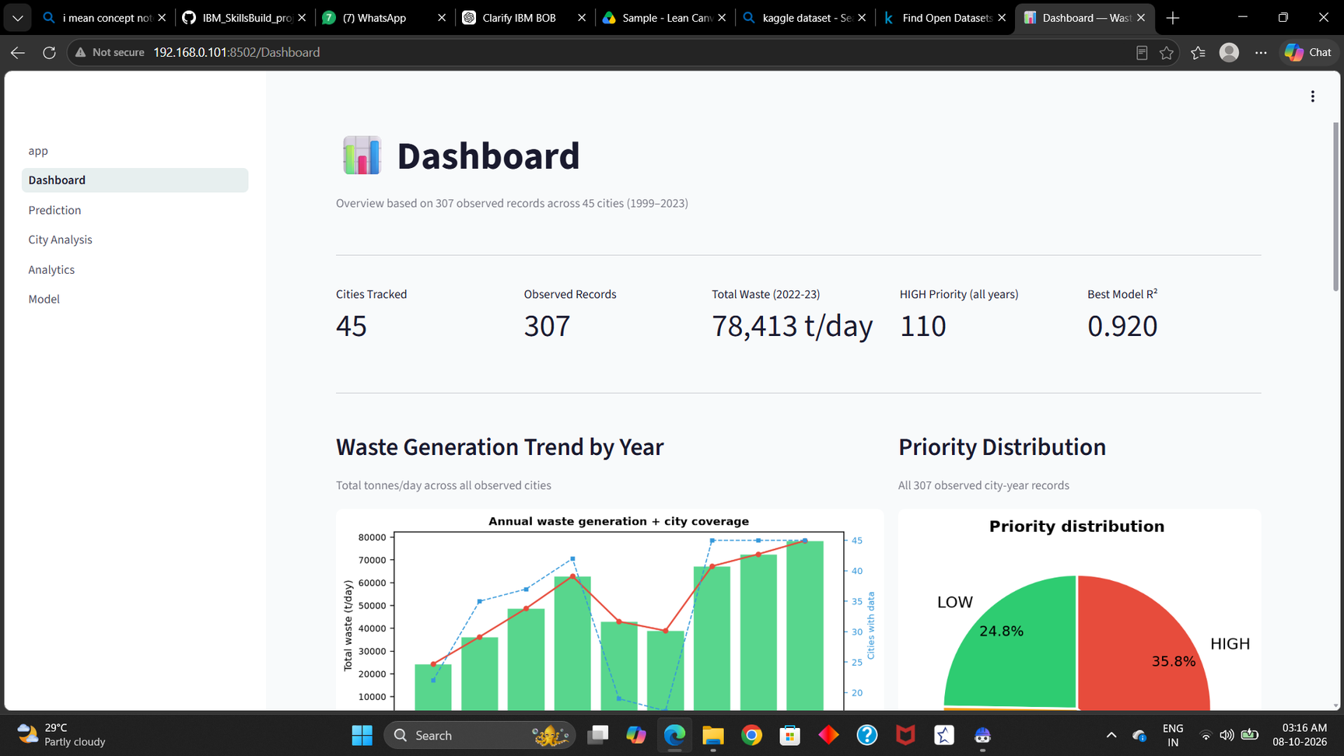
WasteWise AI Dashboard
Explore · predict · compare · explain
WasteWise AI | Internship Final Project
11

Slide 12
How a user interacts with WasteWise AI
1
SELECT CITY
2
SET POPULATION + YEAR
3
GENERATE ESTIMATE
4
VIEW WASTE
5
REVIEW PRIORITY + DRIVERS
Delhi · 2024 → ≈ 10,084 t/day → HIGH priority
Example model estimate, not official waste data
WasteWise AI | Internship Final Project
12

Slide 13
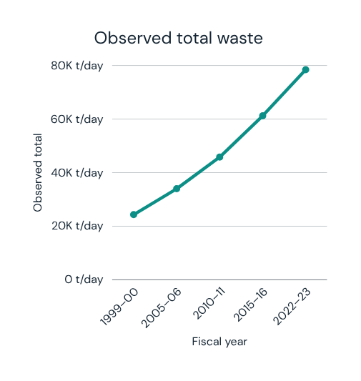
Key results
581.7
0.920
405.9
RMSE · t/day
R²
MAE · t/day
0.463
45
119
CV log-RMSE
modelling cities
tests passing
24,311 → 78,413 t/day observed total waste; no causal claim.
WasteWise AI | Internship Final Project
13

Slide 14
Limitations & responsible use
THE MODEL CAN
THE MODEL CANNOT
✓ Estimate within learned patterns
— Replace official measurements
✓ Compare relative collection need
— Prove causation
✓ Expose model drivers
— Guarantee unseen-city accuracy
✓ Support exploratory planning
— Define an official priority standard
Small, non-uniform data · missing observations · static 2011 population anchor · weak Tier 2/3 subset R² · limited lag features · unseen cities · deployment requires validation and recalibration
WasteWise AI | Internship Final Project
14

Slide 15
Future scope
A staged path from prototype to validated institutional use.
01
CURRENT
PROTOTYPE
03
TEMPORAL +
LAG FEATURES
05
INDEPENDENT
VALIDATION
02
EXTERNAL
COVARIATES
04
RECENT, GRANULAR
MUNICIPAL DATA
06
INSTITUTIONAL
DEPLOYMENT
WasteWise AI | Internship Final Project
15

Slide 16
Transparent estimates.
Practical priorities.
WasteWise AI demonstrates how official municipal-waste data can become transparent ML-based estimates and collection-priority support.
119 automated tests pass
Dataset-first ML · Time-aware evaluation · Explainable dashboard
Analytical decision support — not official waste-management data.
WasteWise AI | Internship Final Project
16

